Slide 1
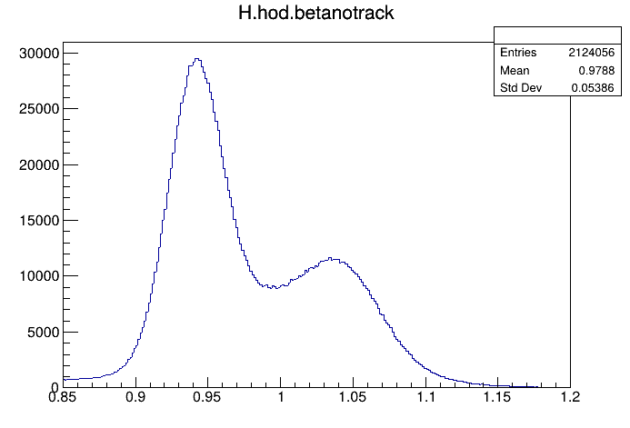

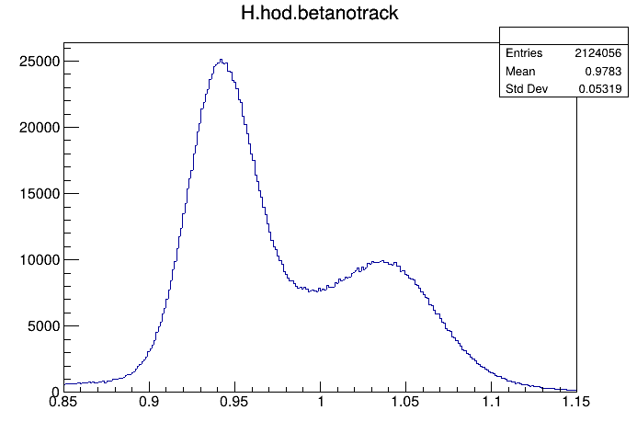
Uncalibrated
Time Walk Calibrated
Fully Calibrated
Notes:
HMS/Protons

Slide 2
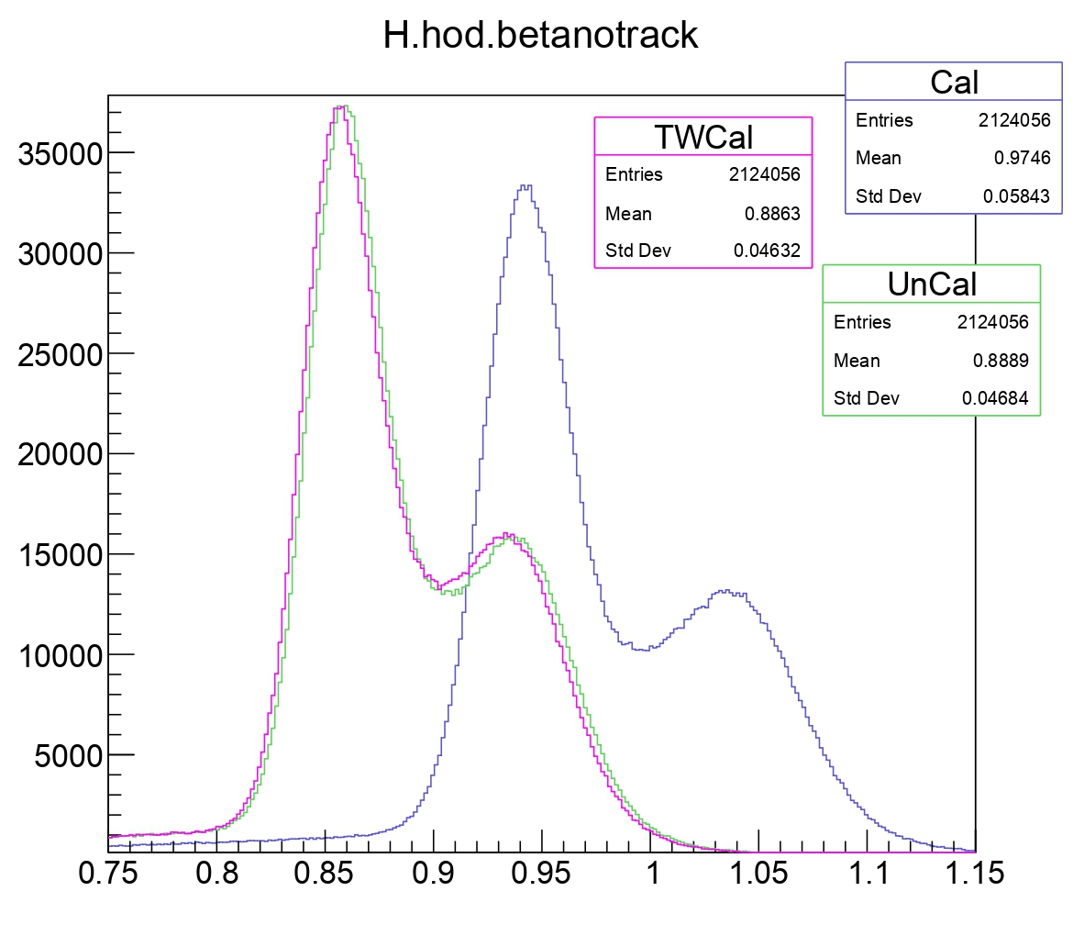

Slide 3
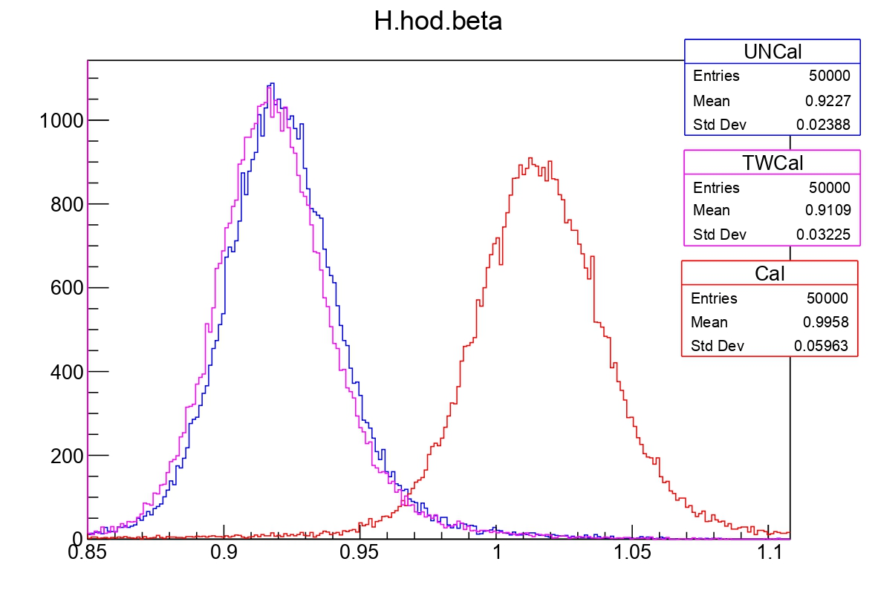

Slide 4
